Slide 1

Household Income vs. Housing Ownership
ST 599 – Big Data Project 1
Sarah Guermond
Andy Olstad
Jasmine Pahukula
Tim Skalland
4 / 25 / 2014

Slide 2
Overview
Data: American Community Survey (ACS)
Distributed each yearly
The ACS collects social, economic, housing and demographic data.
3 yr ACS (2010-2012)
Notes:
The American Community Survey (ACS) is distributed each year to a small sample of the population in each state including Puerto Rico.
It provides updated information for communities to aid in planning efforts in between the main 10-year census survey.
The ACS collects social, economic, housing and demographic data. This report will focus on the economic and housing information for each state.
We use the 2010-2012 ACS set in order to answer the following question of interest.

Slide 3
Question of Interest
How different are the mean household incomes for different household ownership in the US and Puerto Rico?
Household ownership types:
Own with a mortgage or loan
Own free and clear
Rented
Occupied without payment of rent
*Note that Puerto Rico was represented in this data set.

Slide 4
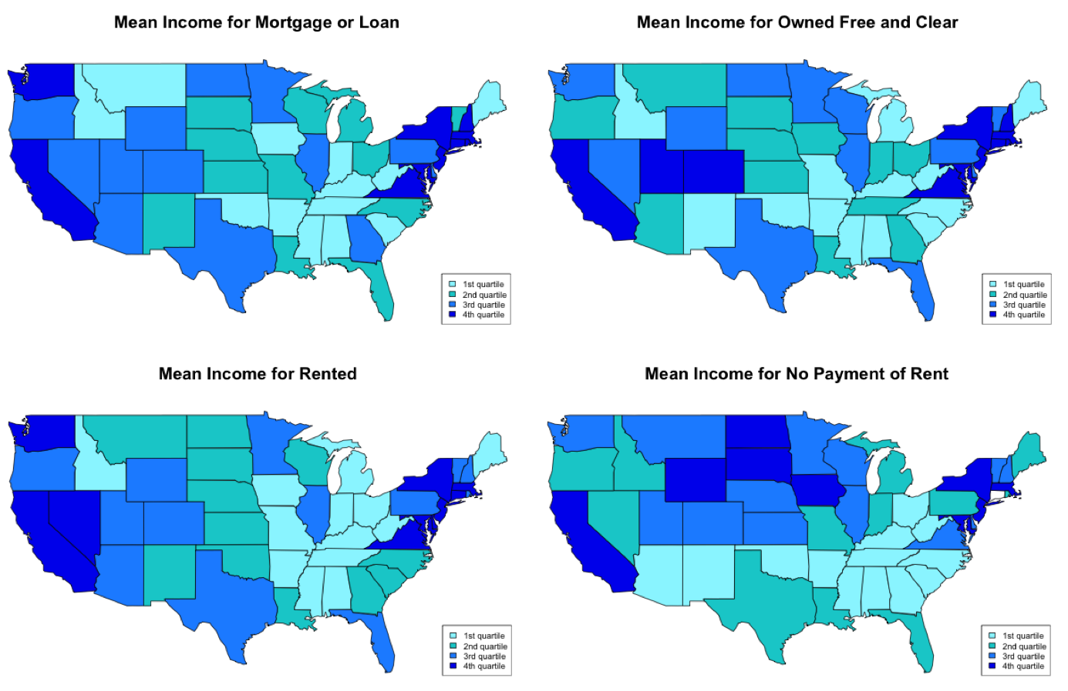
Findings

Slide 5
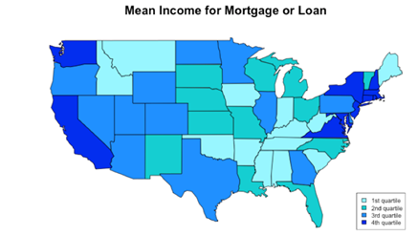
Findings
Highest mean in
Washington D.C. ($154,465)
Connecticut ($126,760)
New Jersey ($124,364)
Maryland ($119,358)
Massachusetts ($118,119)
Similar results for those owning free and clear.

Slide 6
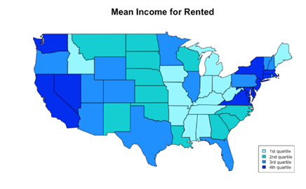
Findings
Highest mean in
Washington D.C. ($62,337)
Hawaii ($58,077)
Alaska ($54,918)
California ($52,423)
Maryland ($52,404)

Slide 7
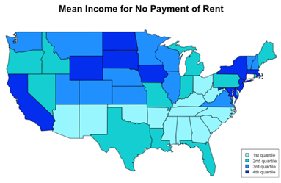
Findings
Highest mean in
Connecticut ($50,264)
Washington D.C. ($49,266)
Hawaii ($47,860)
Massachusetts ($47,224)
New Jersey ($47,081)

Slide 8
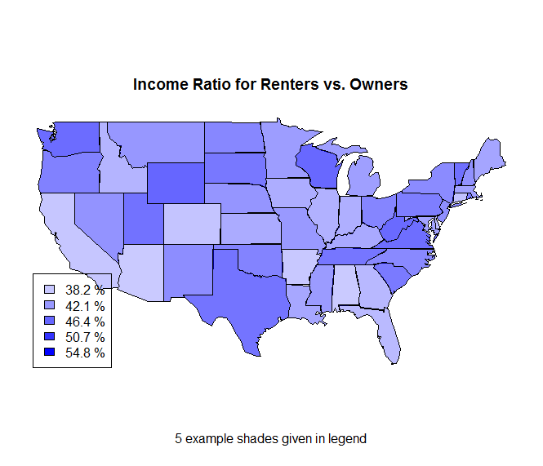
Findings

Slide 9
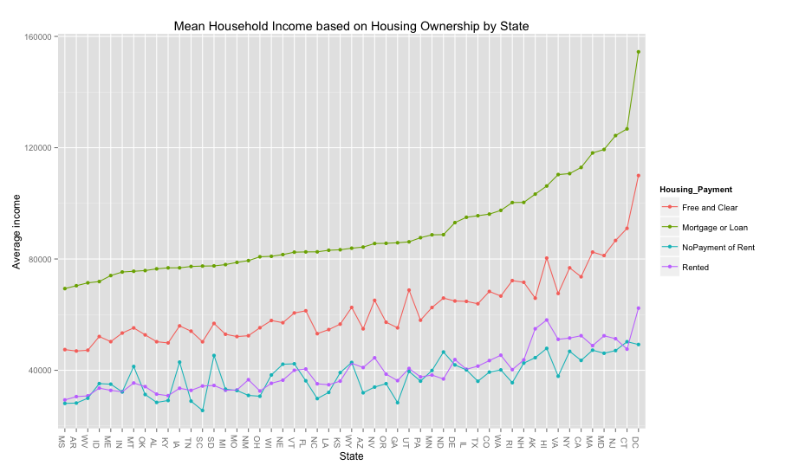
Findings
Notes:
We also notice that households owning with a mortgage or loan had higher mean income than owning free and clear across all states. A possible explanation may be due to retirees (ie: smaller income but likely to have paid off the house). We see that renting and occupying without rent were fairly similar within all states.

Slide 10
Findings
It was interesting to see
Mississippi, Alabama and Arkansas were near the lowest mean household incomes across all ownership types.
Midwest has high income/occupy with no rent
Florida has higher income for owned free and clear than surrounding region.

Slide 11
Obstacles and Solutions
Git setup:
Problem: getting git to work and sync.
Solutions:
Delete local connection, create new version control project in Rstudio, paste changes to new file
Use github for Mac/Windows
File downloads:
Problem: Automating the downloading process of each state from the web.
Solution: Download combined US household data.
Problem: Combined US household data comes in 4 files
Solution: Download all 4, use system() to merge in command line using cat.

Slide 12
Obstacles and Solutions
Data import:
Problem: ~200 x 4 million dataset breaks R when you import it
Solution: Find columns of interest in the command line
(head -n 1 ss12hus.csv | tr ',' '\n' | nl | grep -w 'TEN\|HINCP\|ST\|ADJHSG' | less -S)
use cut -d, -f7,8,40,54 ss12hus.csv to only import 4 columns
Code compatibility:
Problem: 1 mac, 3 windows, windows cannot run command line data fixes
Solution: upload modified data file to git repo so it doesn’t have to be created every time
Accidental branch diversion:
Problem: Code accidentally split into two versions, then merged, breaking code
Solution: Version control keeps track of code at different stages, allowing manual reversion to previous versions

Slide 13
Future Work
Different groups
per state based on year
by region (East, South, West, Midwest)
Examine counts – what proportion of people fall into what category in each state?
Examine differences between each of the 4 household ownership types
Hypothesize that free & clear owners are retired, mortgage payers are still working
Take into consideration negative and null income (we ignored NAs and averaged in negatives).

Slide 14
Future Work
Can get summaries per state based on year
Examine differences between each of the 4 household ownership types
Hypothesize that free & clear owners are retired, mortgage payers are still working
Examine by region (East, South, West, Midwest)
Take into consideration negative and null income
Examine counts – what proportion of people fall into what category in each state?
Include weighting: this analysis pretended the ACS data was from a simple random sample. When we ran a few states with the weighting, average incomes increased.

